Slide 1

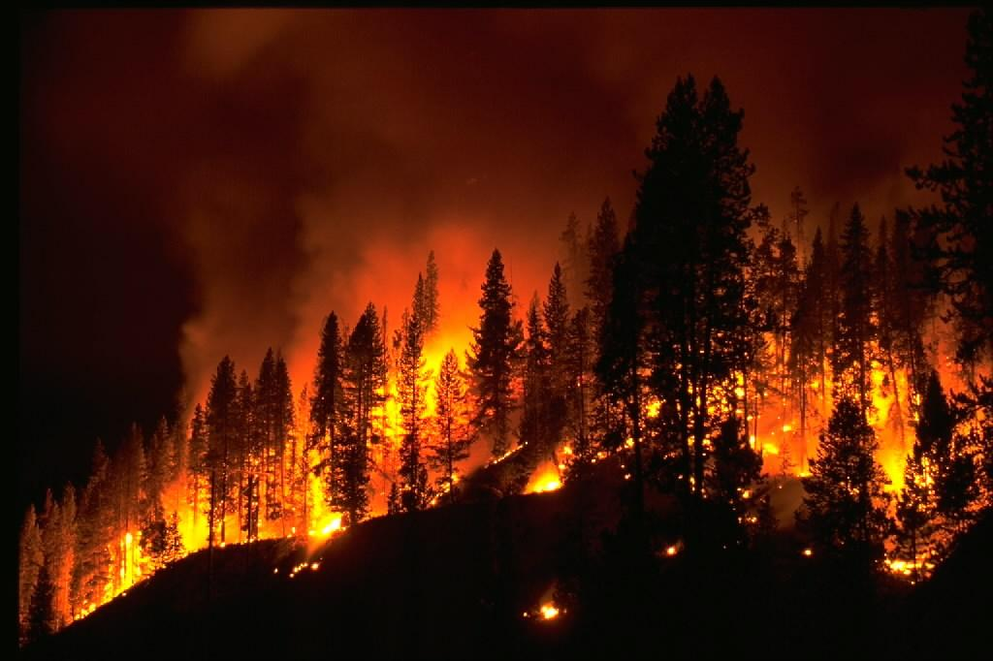
Programming for Data Analysis ,Research and Statistics
Forest Fires Based on Meteorological Analysis
By-Khubim Kumar Chhetri
D00251757,DKIT
Notes:
1

Slide 2
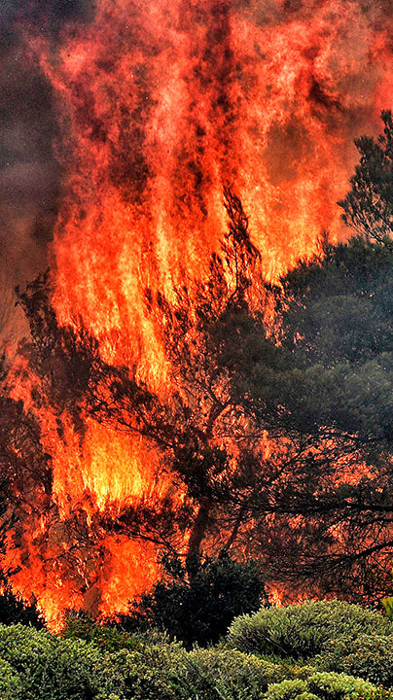
1
Overview
2
Geographical Analysis
3
Meteorological Analysis
4
Prediction Model
5
Q&A

Slide 3

1
Overview
Part

Slide 4
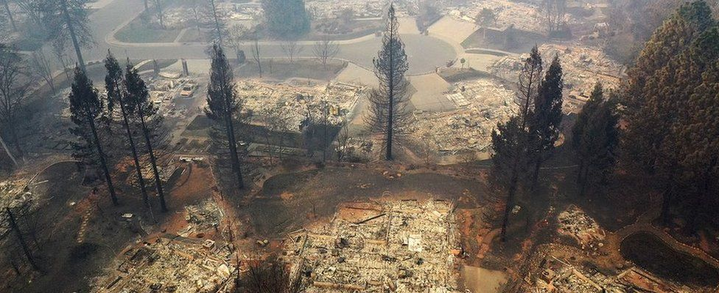
Outline
Catastrophic effects on human and nature
Over $2 billion spent on fighting forest fires Everyyear
Causes are hard to track and analyze
Notes:
Woolsey hundreds of casualties, thousands abandoned and fled homes and businesses
as of now no conclusion on cause

Slide 5
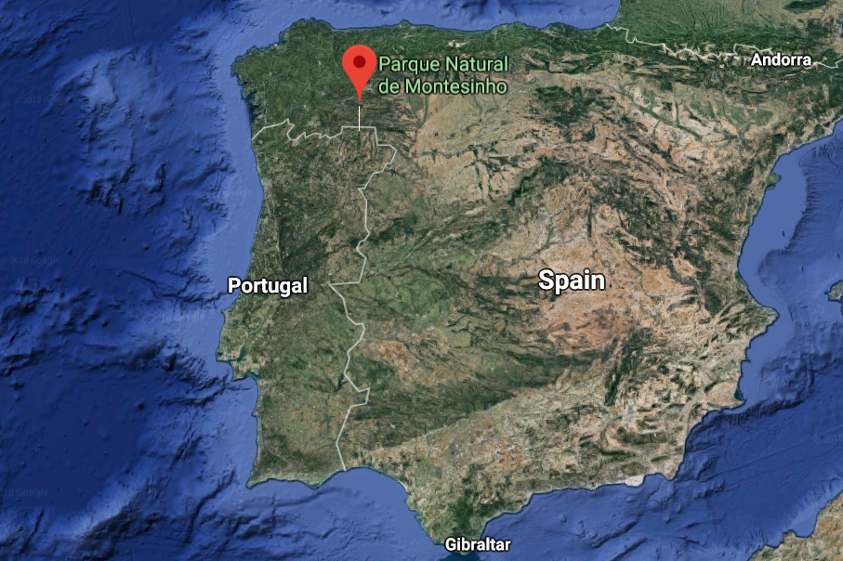
Dataset
All data comes from North African country,
recorded in the format of
Forest Fire Weather Index (FWI)
Each entry contains 13 attributes including
time, location, natural as well as
arbitrary factors.
Notes:
Supra-Mediterranean weather
recorded in a span of 2 years
(total 517 incidents)
quite a lot of detail

Slide 6
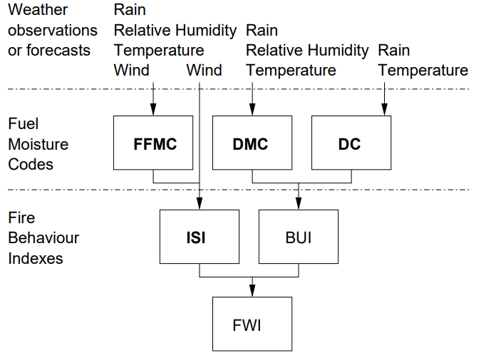
Preliminary Model
Moisture Content
Fire Velocity
Amount of fuel
Fire Intensity
Notes:
represent the moisture content of shallow and deep organic layers, which affect fire intensity

Slide 7
Objectives and methodology
1
Analyze correlations and dominant factors of forest fires
Cross analysis of fire incidents with sets of associated factors
Observation of fire trends in areas and time
2
Remove abnormal points and refine data
Test prediction model with dominant factors
Test findings with prediction model

Slide 8
2
Geographical analysis
Part

Slide 9
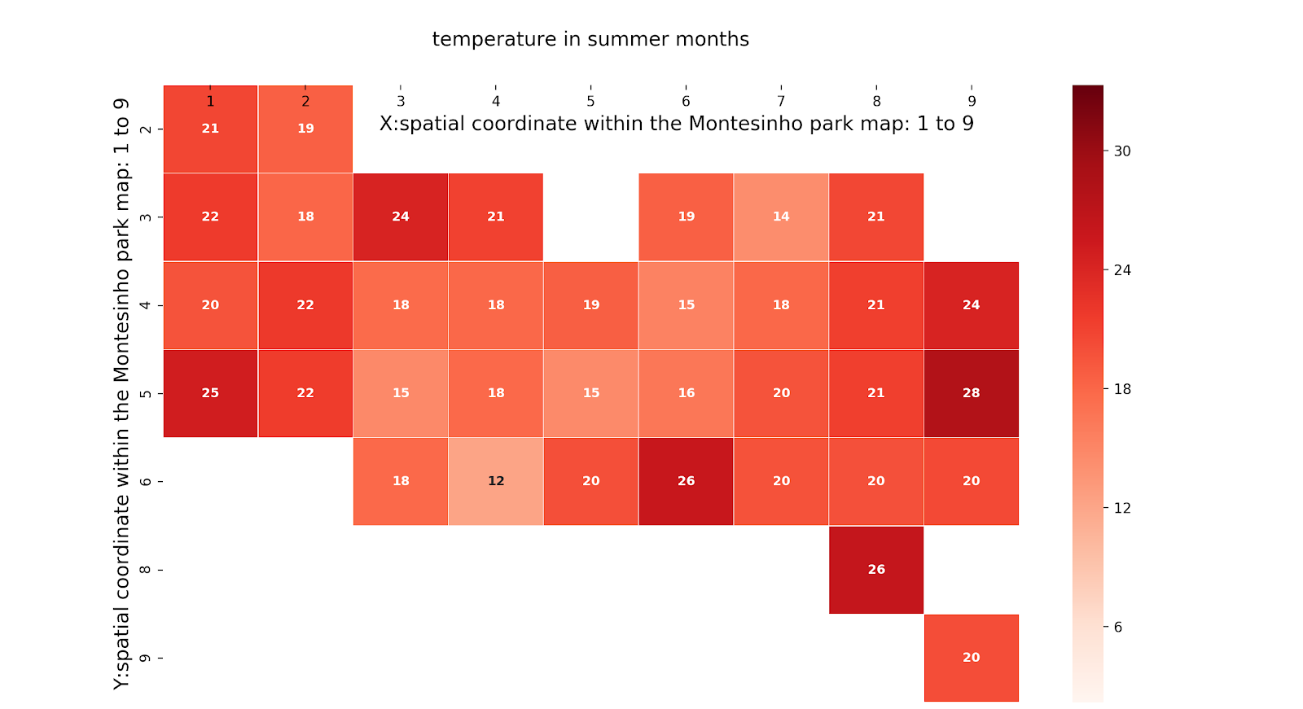
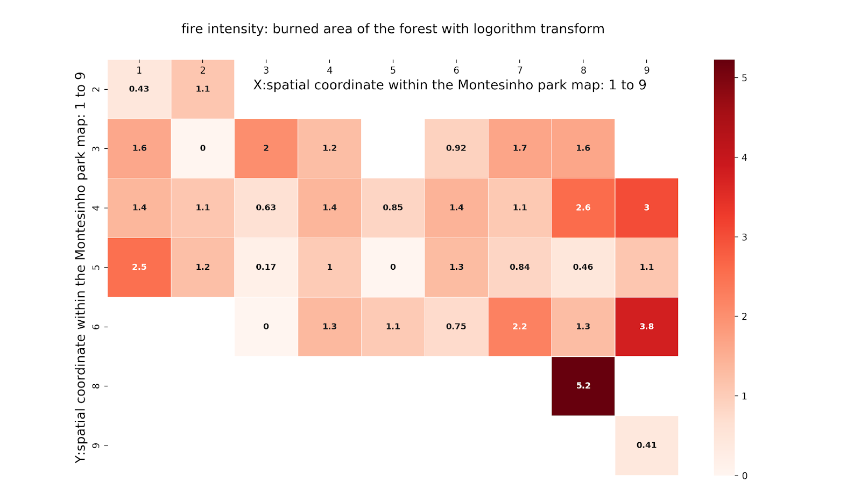
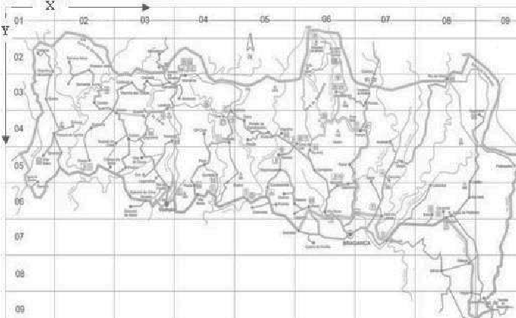
Temperature in summer months
Geographical Analysis
Fire intensity: area burnt of the forest
Notes:
Plot of intensity of fires at different co-ordinates
intensity(ln(x+1))

Slide 10
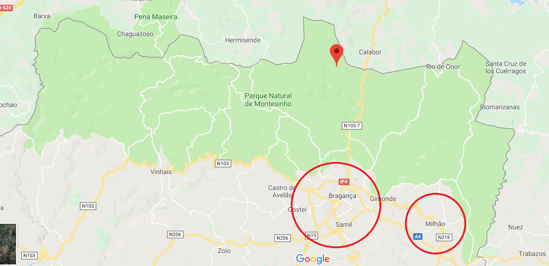
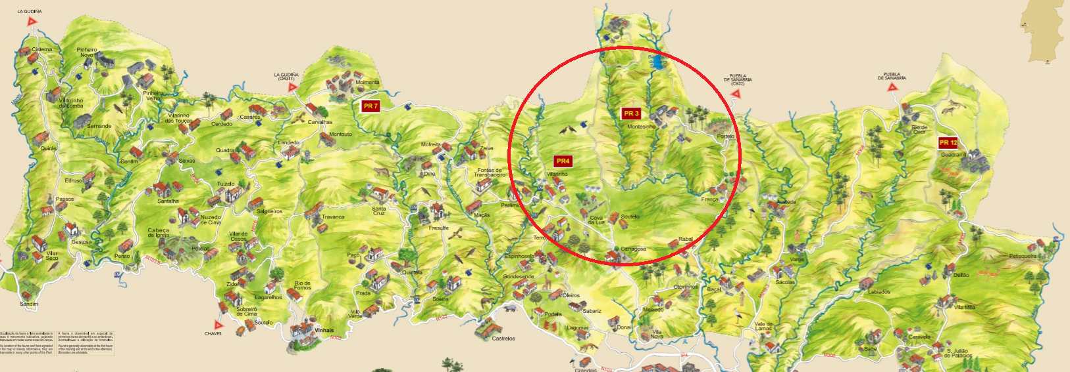
Geographical Analysis
Many cities, towns and highway intersections located near the southeast region of the park
Higher human footprint tends to cause higher intensity and probability of fires.

Slide 11
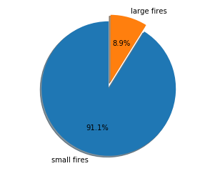
Geographical Analysis
This park is prone to smaller fires than big ones.
Small fires are usually a result of irresponsible human behaviors.
Large fires: area > 50 ha

Slide 12
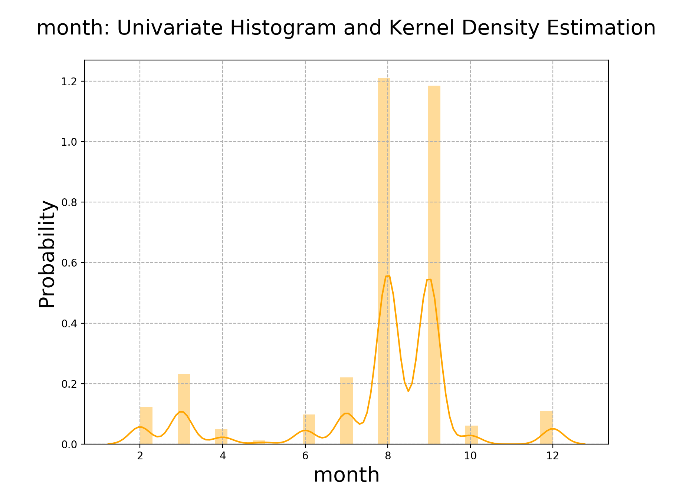
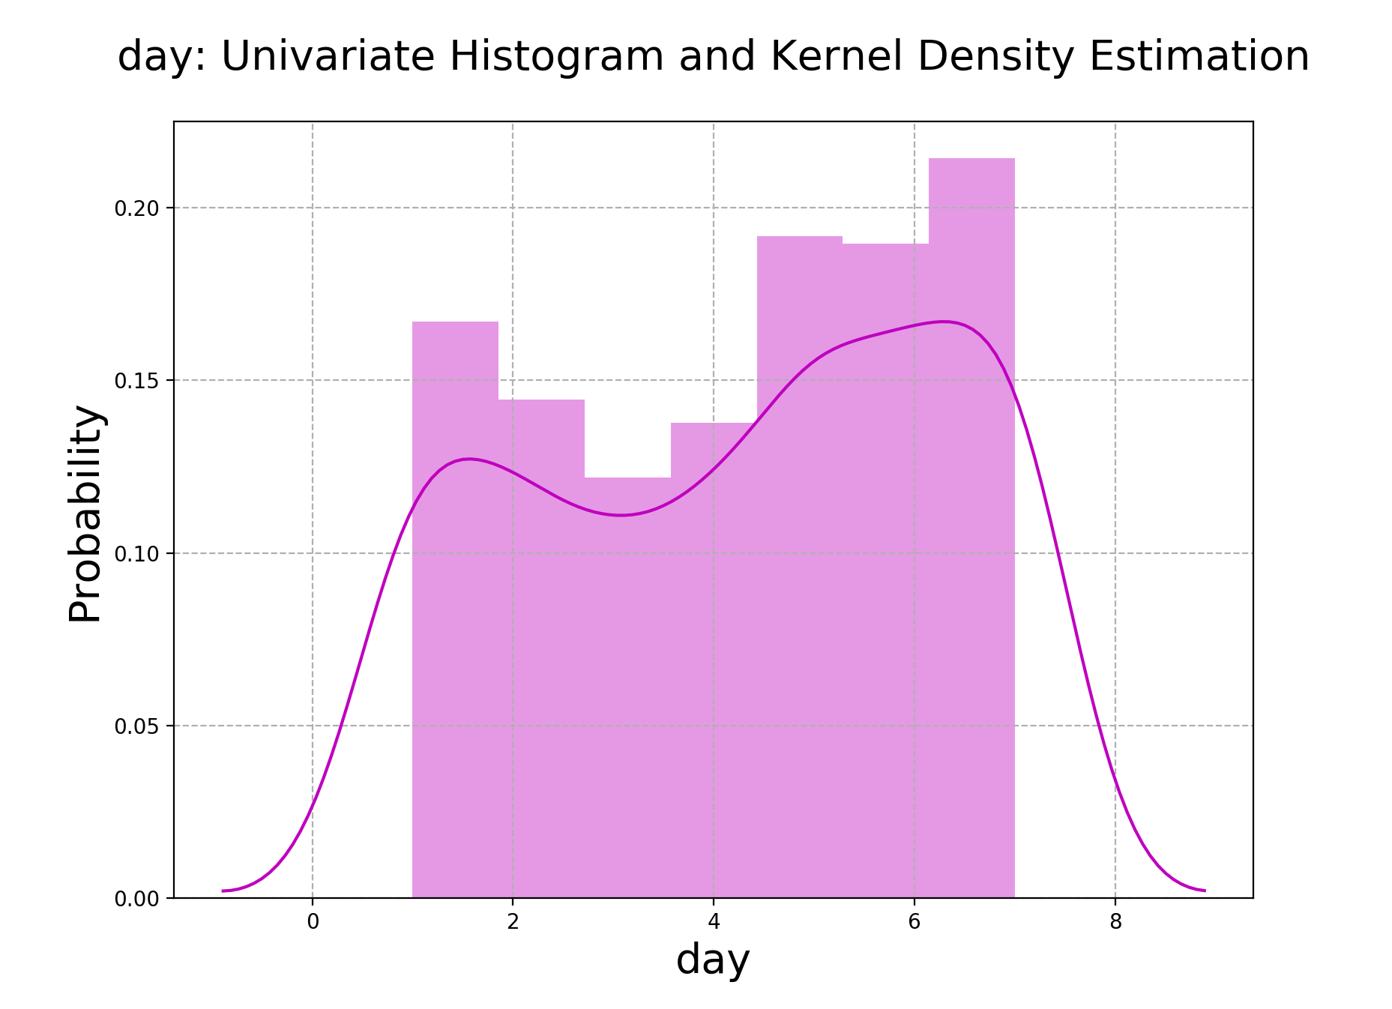
Geographical Analysis
Higher frequency of fires observed in weekends and summer months (mostly holidays)
Areas closer to towns also see a higher frequency in fire occurrence
1-Mon to 7-Sun
Notes:
improve firefighting resource management near cities and villages

Slide 13
3
Meteorological analysis
Part

Slide 14
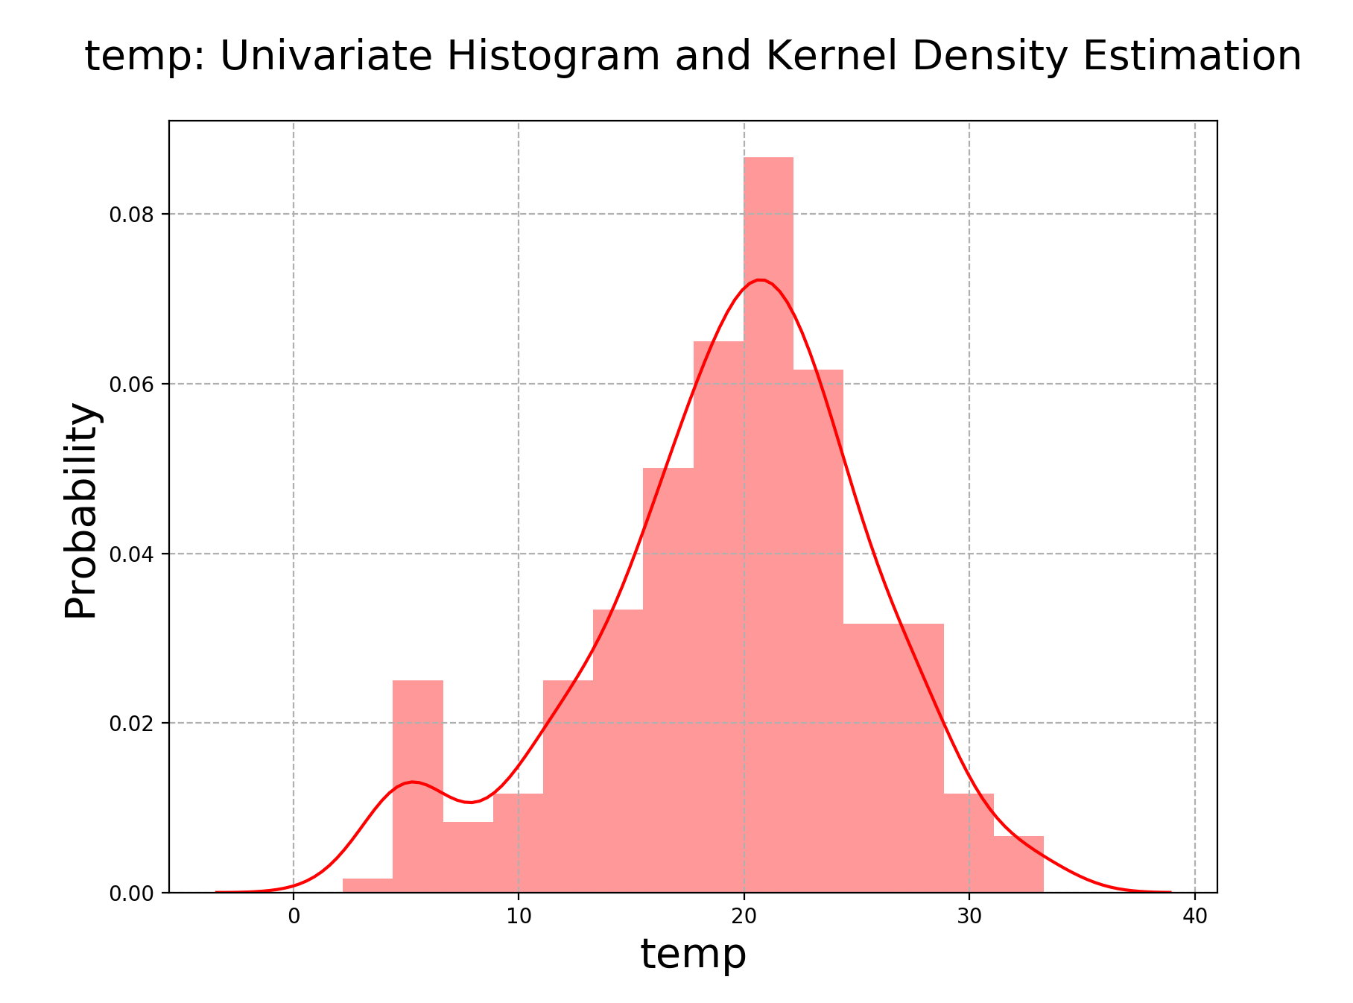
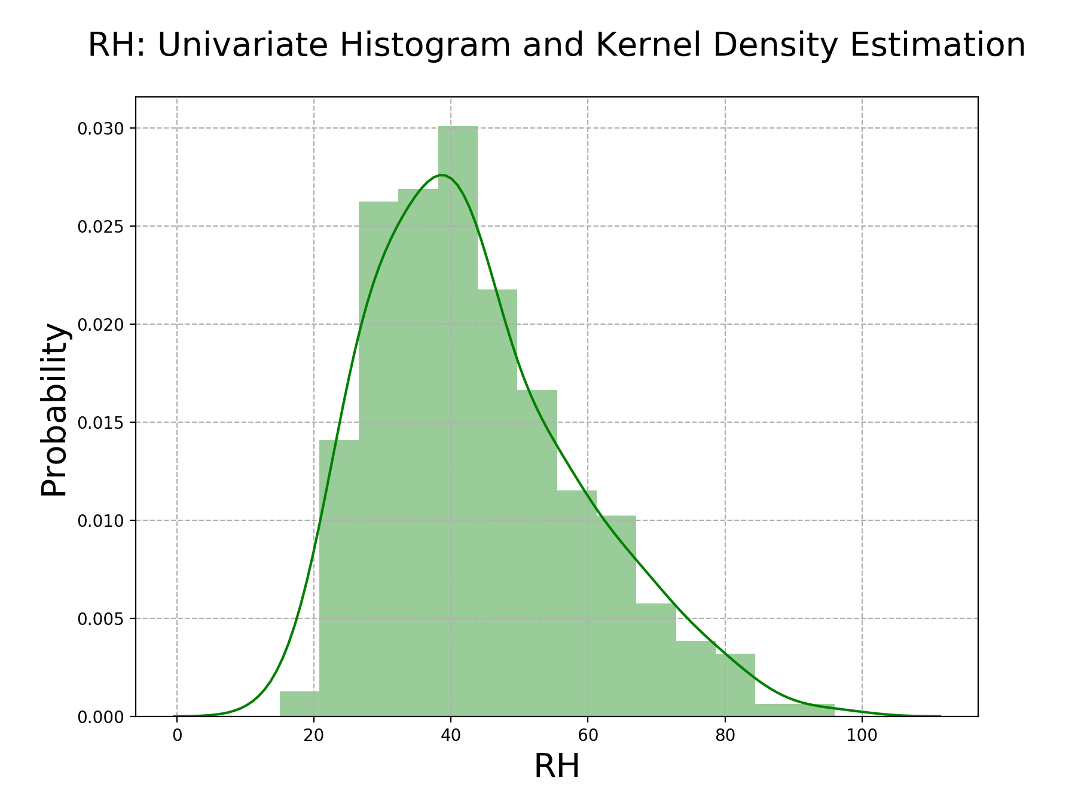
Meteorological analysis in fire cases
Normal/Gaussian Distribution

Slide 15
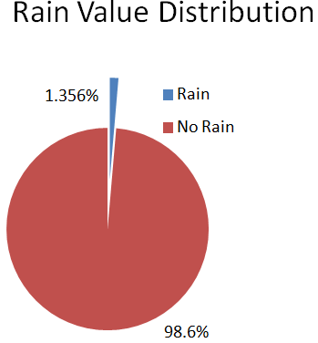
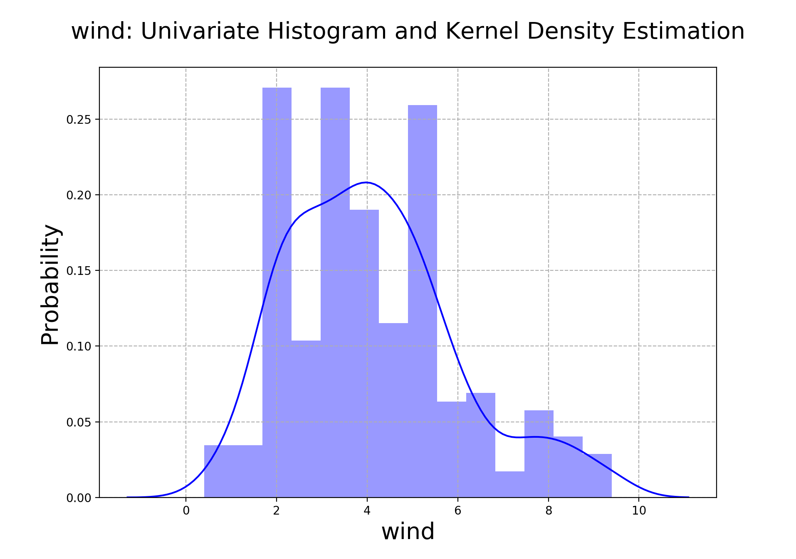
Meteorological analysis in fire cases

Slide 16
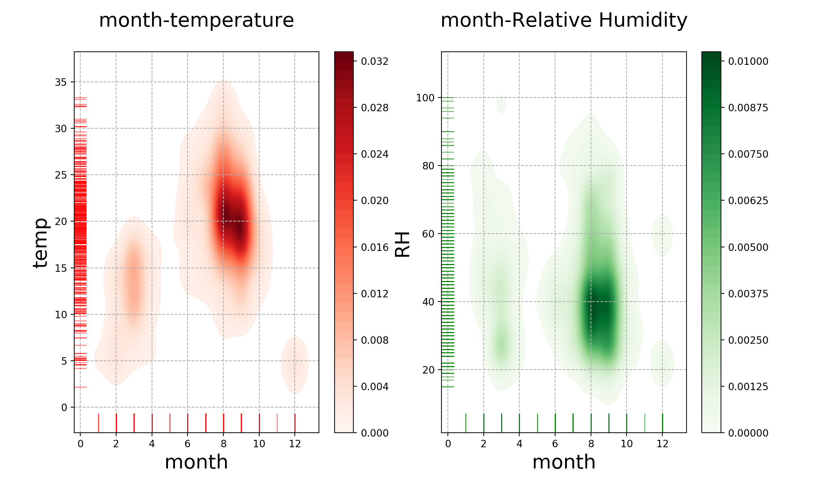
Meteorological analysis in fire cases
Alert of forest fires: summer/early fall + [15℃,30℃] + [25%,50%]RH

Slide 17
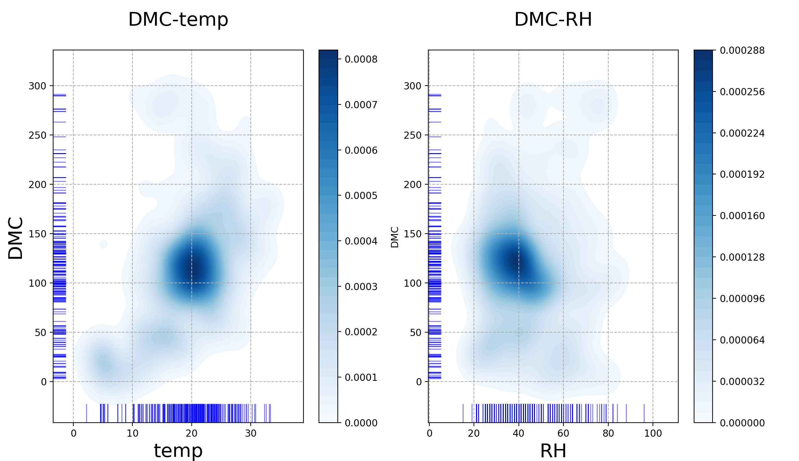
DMC values in the interval [80,150] are alerts of intense fires
Forest fire indices and meteorological factors
DMC (Duff Moisture Code)

Slide 18
4
Prediction Model
Part

Slide 19
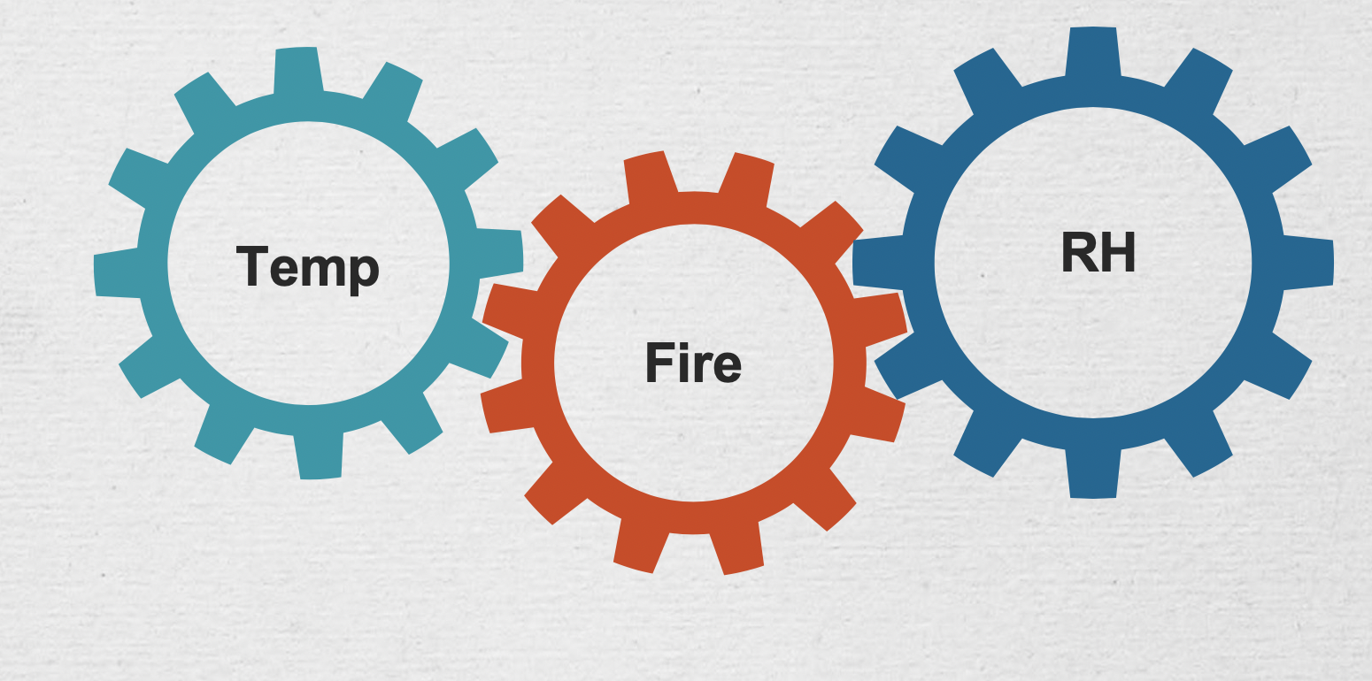
Conclusion and suggestions
Anthropic causes of fire
Improve firefighting resource
management near cities in certain times of the year
Stay aware and conscious of your actions and
surroundings
Natural causes of fire
High temperature and dry environment leads to high risks of fires
Focus on the Summer and early Fall

Slide 20
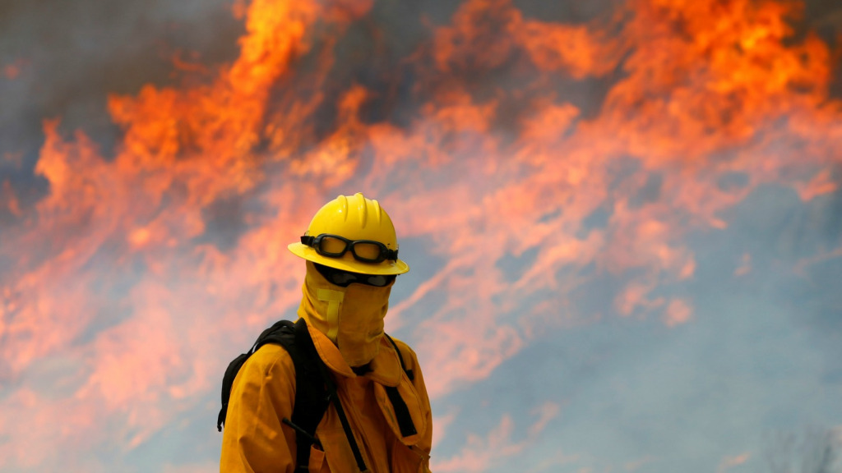
Thank you!

